Slide 1


IPL Match Winner Prediction Using Machine Learning
Presented by
Subhiksha | DADS November batch | 16 May 2025

Slide 2

Introduction
Objective
Dataset
Predict IPL match winners before the game for strategic insights.
Includes match details from 2008 to 2019: teams, venue, toss, results.
Use Case
Supports teams and analysts in decision-making and betting strategies.

Slide 3
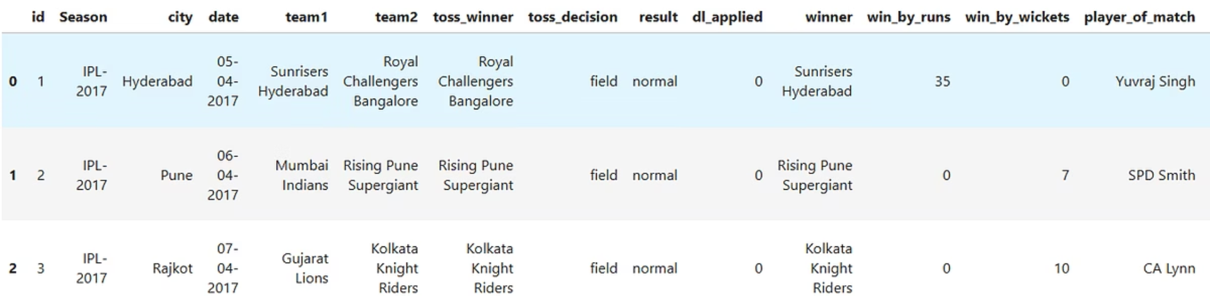
Data Understanding
Dataset Overview
Key Features
Historical IPL match data from 2008 to 2019 (12 yrs)
season, city, date, team1, team2
Contains information related to match conditions, teams, and outcomes.
toss_winner, toss_decision, result, dl_applied
winner, win_by_runs, win_by_wickets
player_of_match, venue, umpire1, umpire2

Slide 4
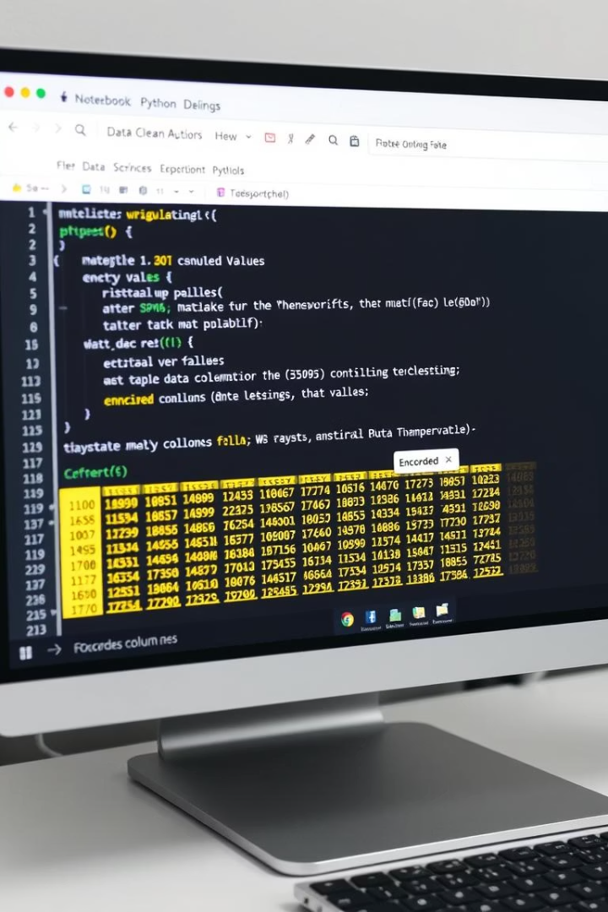
Data Cleaning
Irrelevant Columns
Missing Values
Dropped as irrelevant to match outcome prediction.
Handled missing values in winners and city fields.
Encoding
Standardized data
Converted categorical features to numerical format using Label Encoding.
Standardized team names using a mapping dictionary to merge variations

Slide 5
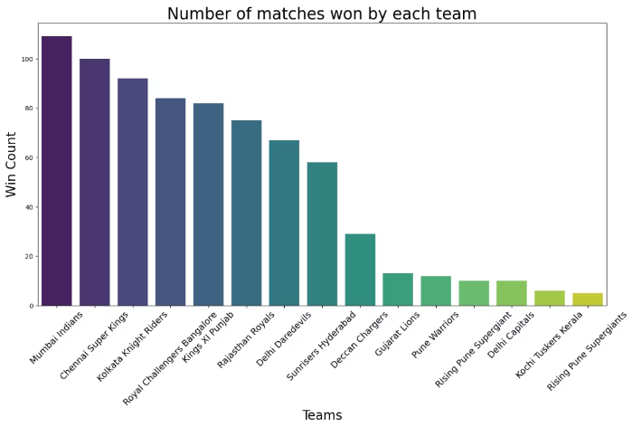
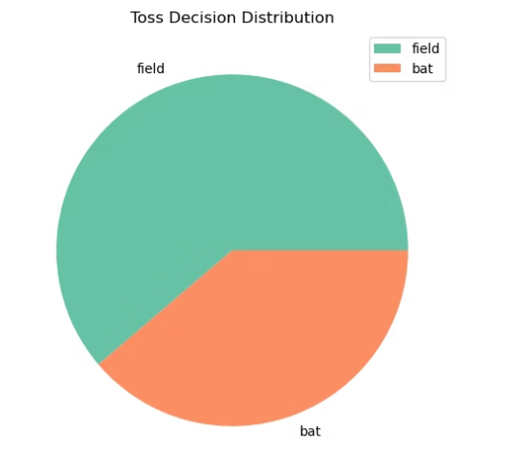
Exploratory Data Analysis (EDA)
Top Performers
Toss Insights
Toss Impact
Venue Influence
Historically, MI and CSK have been the most successful IPL teams.
Teams winning the toss tend to opt for bowling first.
Teams that win the toss are more likely to win the match
Certain stadiums provide a home ground advantage to particular teams.

Slide 6



Modeling Process
Models
Techniques
Logistic Regression
RandomizedSearchCV for hyperparameter tuning
K-Nearest Neighbors
Support Vector Machine
Evaluation metrics: Accuracy score, Classification report, Confusion matrix, Precision score, Recall score, f1_score
Decision Tree
Random Forest
XGBoost

Slide 7
Model Comparison
Model
Accuracy
Logistic Regression
28%
SVM
40%
KNN
38%
Decision Tree
86%
Random Forest
79%
XGBoost
97%
→ XGBoost excels in handling categorical features and calculating feature importances.

Slide 8
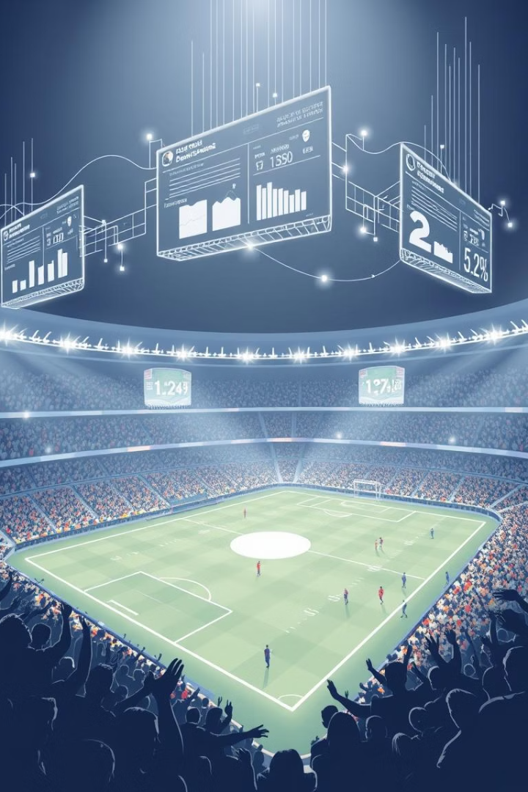
Conclusion & Future Work
Future Data Features
Application
Develop a real-time web app for ongoing predictions.
Incorporate player form, weather, and live match data.
Advanced Techniques
Explore ensemble models for higher prediction accuracy.

Slide 9

Q&A
Thank you for your attention.
Open for questions and feedback.

